Slide 1

Design of Non-Volatile Latch using Resistive Memory Technology
ADVISOR: Dr. HAMID MAHMOODI
GROUP MENTOR: ALIYAR ATTARAN
MEMBERS: VLADISLAV MIFTAKHOV CODY DEL PRATO
SØREN TORNØE KWAN LIM
School of Engineering
San Francisco State University, San Francisco, CA
July 2017

Slide 2
Overview
STTRAM Technology, MTJ
Non-volatile (NV) PreCharge latch
Logic Gates and Write Operation
Read Operation
Research Goals
Experimental Analysis
Results
Future Tasks

Slide 3
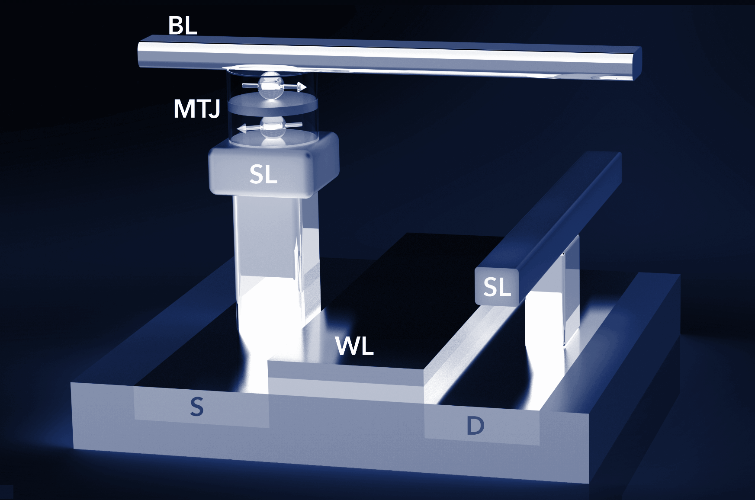
Spin Transfer Torque Random Access Memory (STTRAM)
Resistive memory technology to replace traditional charge-based memory.
Information storage by use of magnetic orientation
CMOS compatibility, scalability, non-volatility, low power
Figure 1: MTJ and Access Transistor
Cell consists of Access Transistor and Magnetic Tunnel Junction (MTJ)

Slide 4
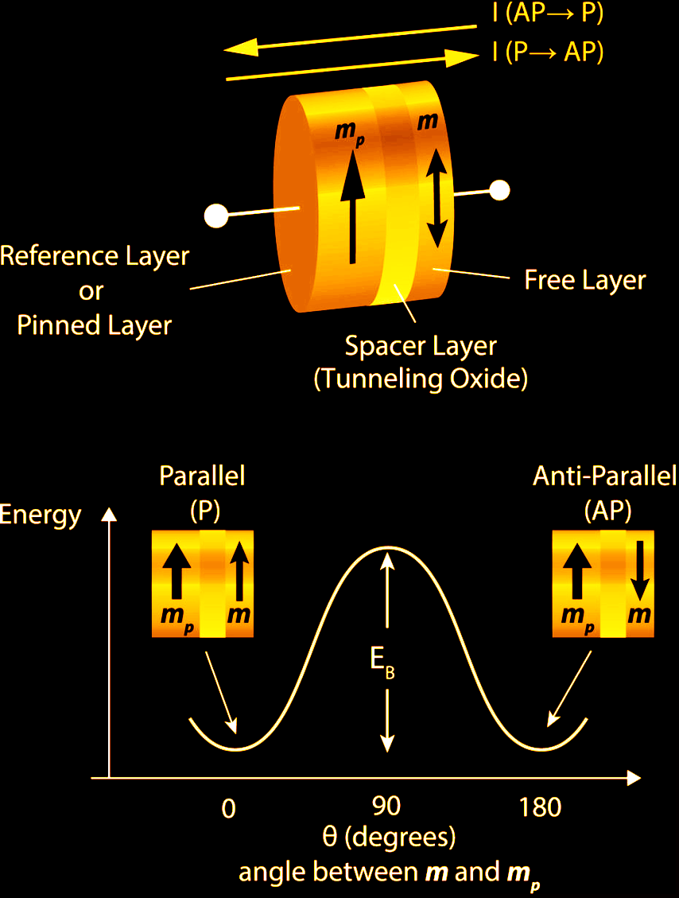
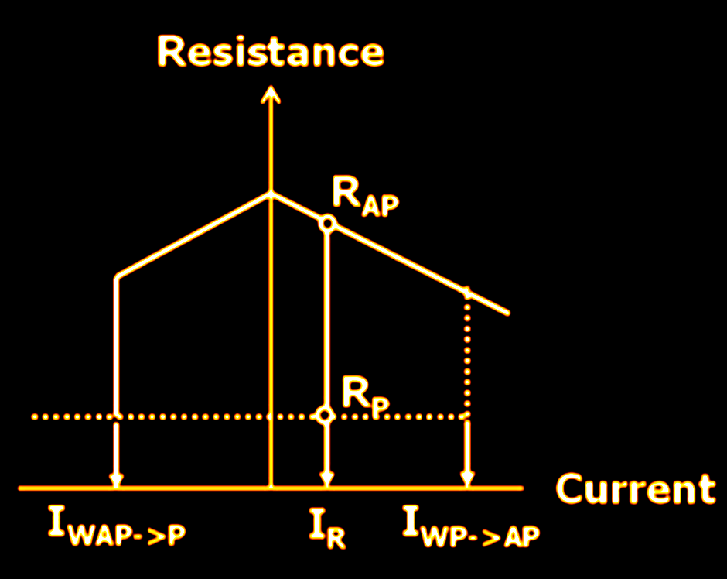
Magnetic Tunnel Junction (MTJ)
Figure 2: MTJ Specs
Composed of an oxide layer in between two ferromagnetic layers; one free and one pinned.
Information stored as high and low resistance; parallel and antiparallel states.

Slide 5
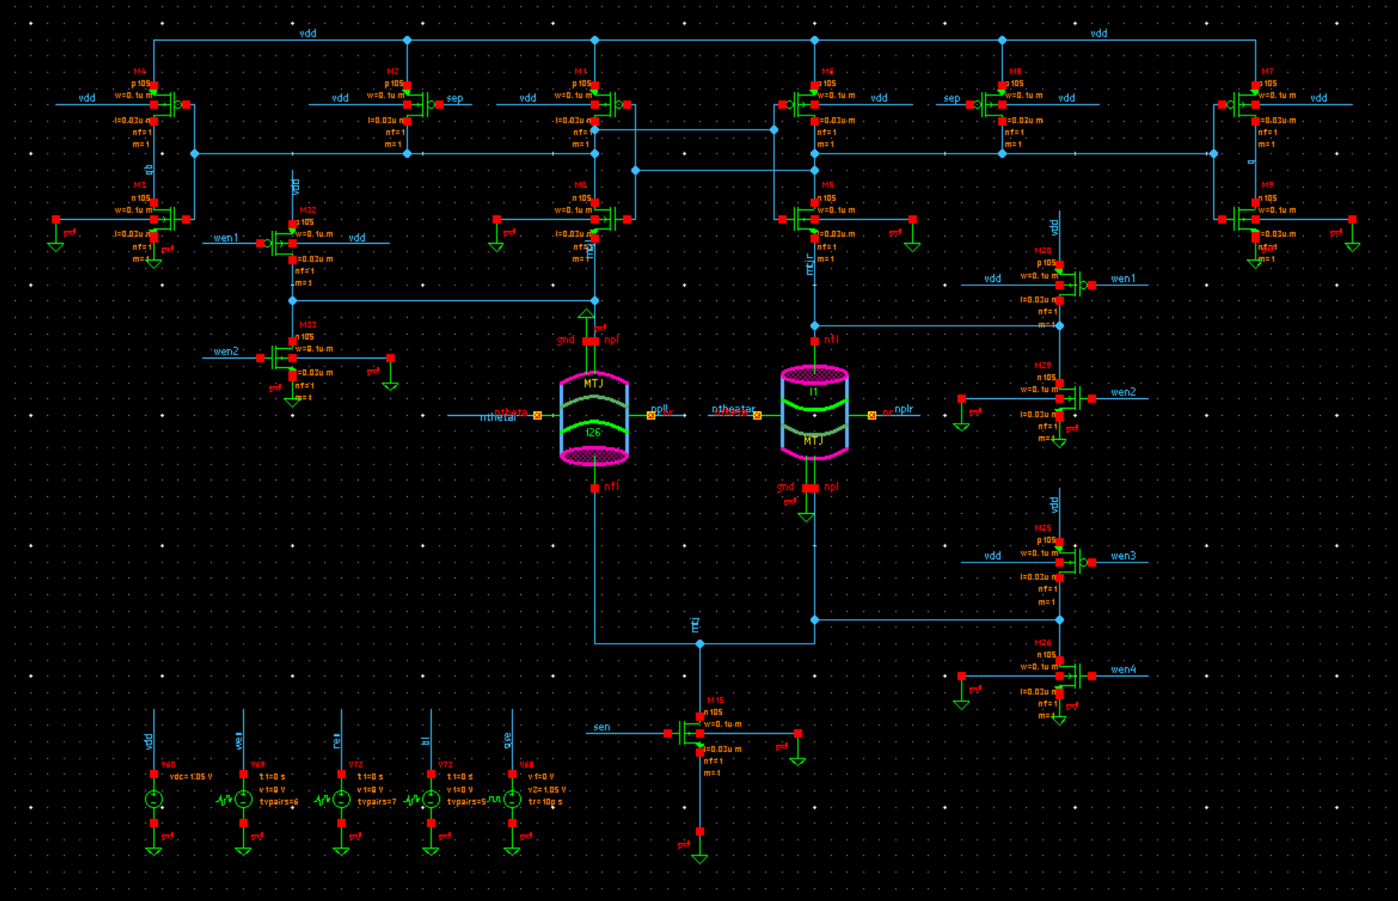




PreCharge Latch
Schematic
SENSE AMPLIFIER/ READ TRANSISTORS
WRITE TRANSISTORS
MTJs
INPUT SIGNALS
Figure 3: PreCharge Latch Schematic and Input Signals

Slide 6
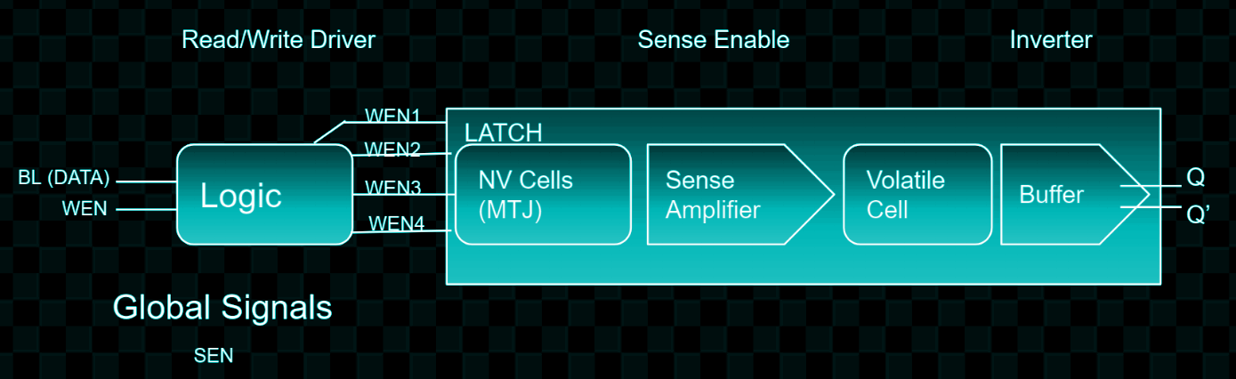
Non-Volatile (NV) Precharge latch
Logic simplifies inputting signals for read and write operations.
WRITE
Write Driver Signal from WEN causes MTJ/NV Cell state to be overwritten
MTJ state changed to match BL data entered.
READ
Sense Amplifier receives signal from Global Signals SEN
Based on state of non-volatile cell, Sense Amplifier sets the state of the volatile cell; outputs Q and Q’
Figure 4: PreCharge Latch Flow Chart Diagram

Slide 7
Control Logic
Wen 1,2,3,4 in certain pattern to determine current (up to down or down to up).
Data | Wen | WEN1 | WEN2 | WEN3 | WEN4
0 | 0 | 1 | 0 | 1 | 0
0 | 1 | 1 | 1 | 0 | 0
1 | 0 | 1 | 0 | 1 | 0
1 | 1 | 0 | 0 | 1 | 1

Slide 8
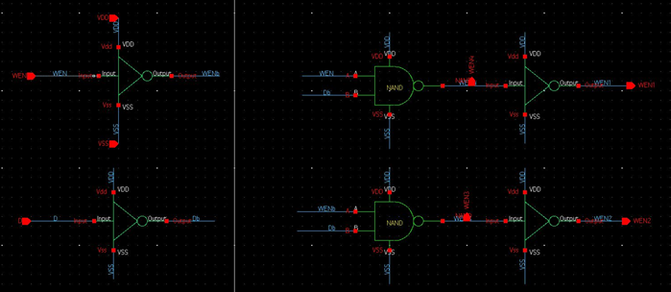
Control Logic Gates
Composed of Inverters and Gates
Input: ideal sources BL (Data) and WEN
Generates the signals to flip MTJ
Generates input signals to write
Figure 5: Logic Schematic

Slide 9
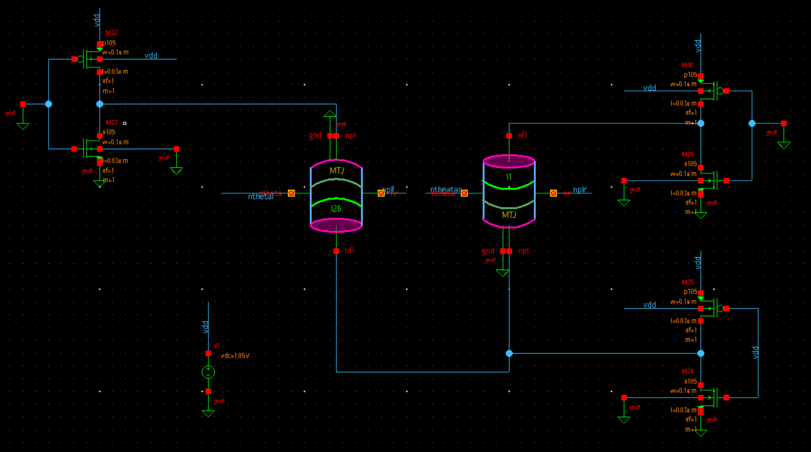
Write Operations
WRITE (up to down) 1 0

Slide 10
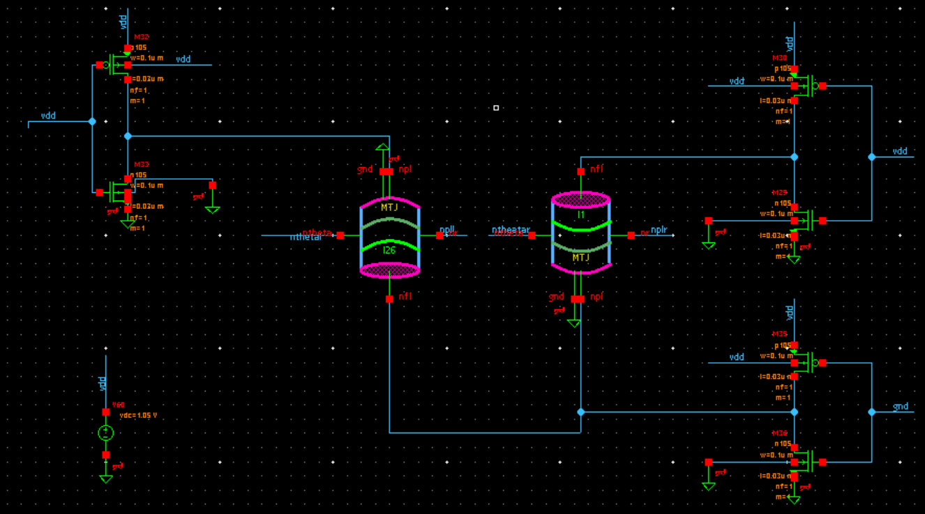
Write Operations 2
WRITE (down to up) 0 1

Slide 11
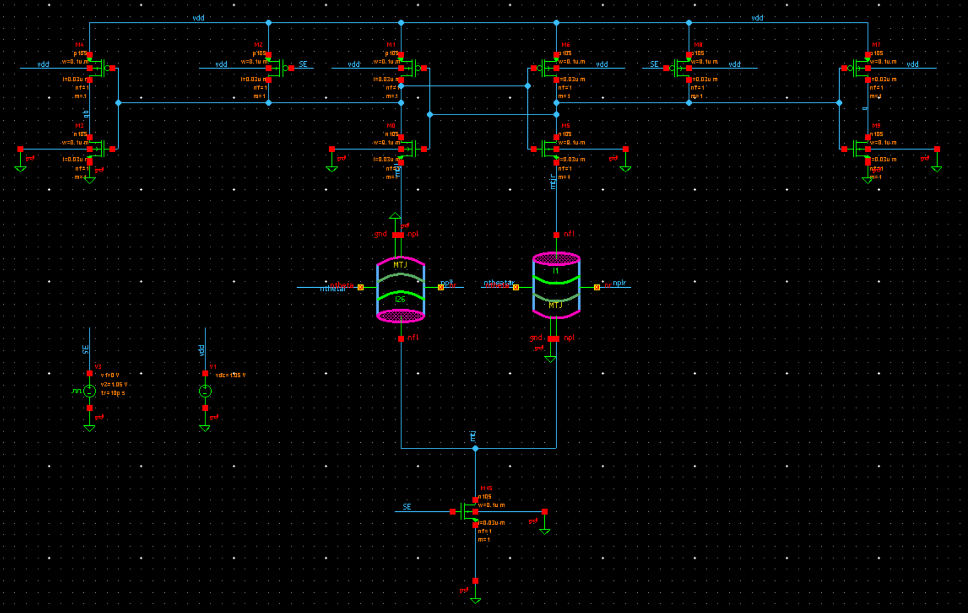




Read Operations
Buffer Inverter
VDD Pmos
Latch-ception
Ground Nmos
Figure 8: Read Operation Schematic

Slide 12
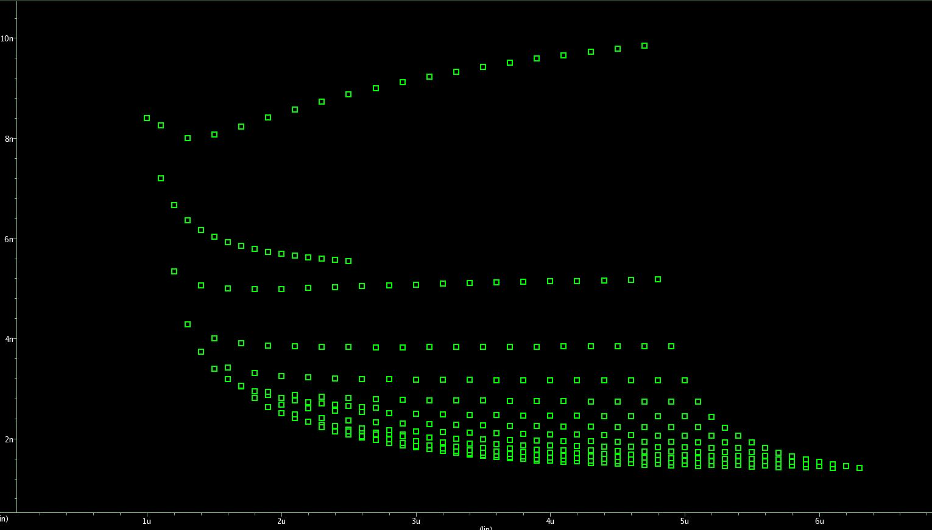
Delay and Area
Delay measured as how long for MTJ to switch after current signal reaches it.
Over 15 nanoseconds: Failure.
Area is the summation of all transistor widths being tested.
Delay (ns)
Figure 9: Delay and Area Diagram
Area (u)
Notes:
In write operation, delay occurred whenever writing a value to the MTJs. Since there are only two operations we are looking at, write01 and write10, we only measured two delays. The maximum between these two was taken and is from here on referred to as just “delay”.
As for the graph, just say it is a graph of passed delay vs area runs. No need to explain more. Just needed a pic here, the emphasis is on the terms delay and area. In read operation there are also two delays depending on whether the MTJs are oriented as 01 or 10.

Slide 13
Research Goals
Sweep Individual Transistors in Full Latch
Sweep Full Write Cycle
Write Cycle Optimization
Write Cycle Failure Rate Simulations
Sweep, Optimize, Simulate Read Cycle
Latch Layout

Slide 14
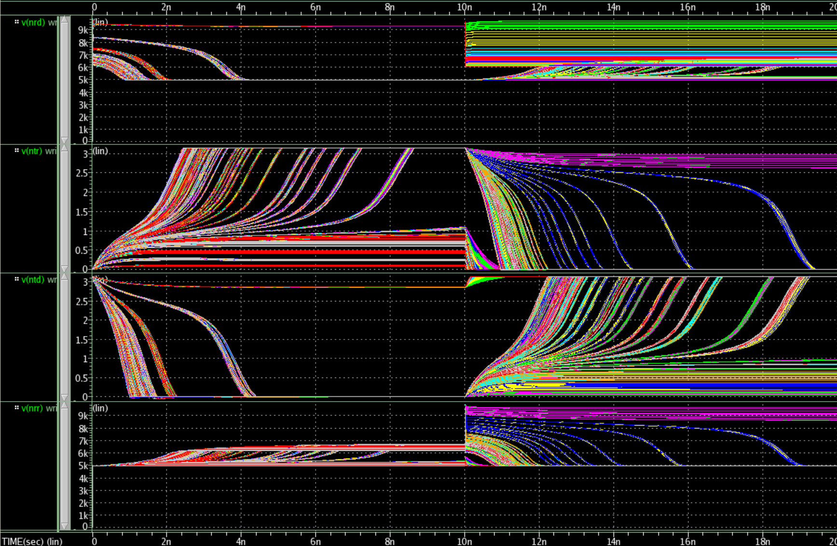
Individual Transistor Sweeping
MTJd resistance
FAIL
FAIL
PASS
MTJr theta
MTJd theta
MTJr resistance
Time (s)

Slide 15
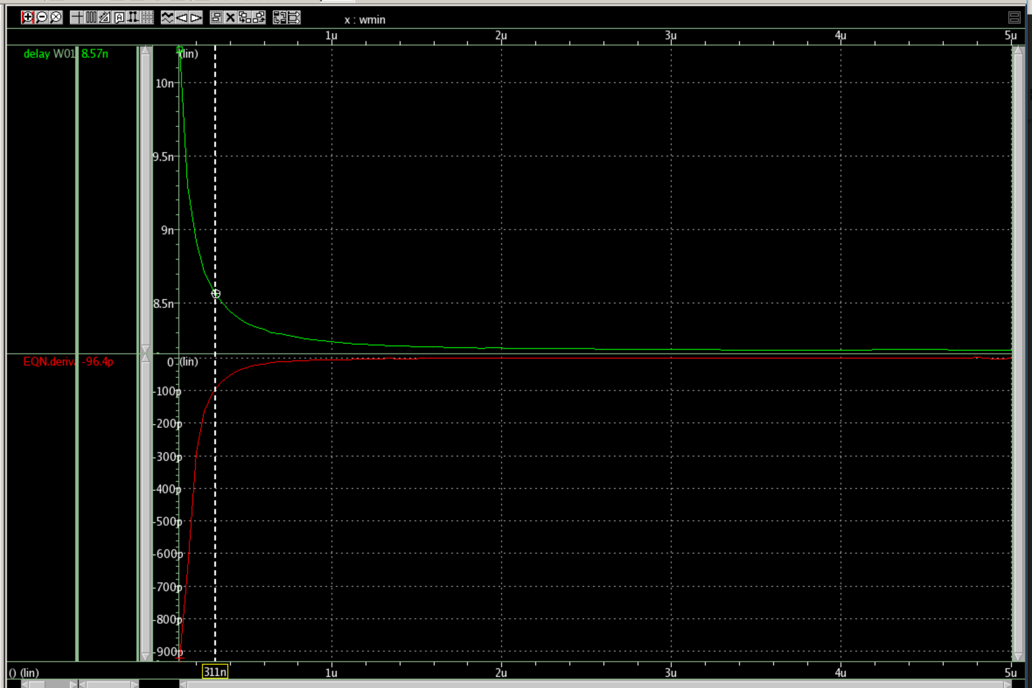
Individual Transistor Delay vs Width
Sensitive
Delay
Delay (s)
Width
SATURATION
Minimum Size
Delay (s)
Delay
Width
Width (m)
Notes:
over design

Slide 16

Individual Transistor Sensitivity
Sensitive
Delay
Width
Minimum Size
Delay
Width
Figure 12: Individual Transistor Sensitivity Schematic

Slide 17
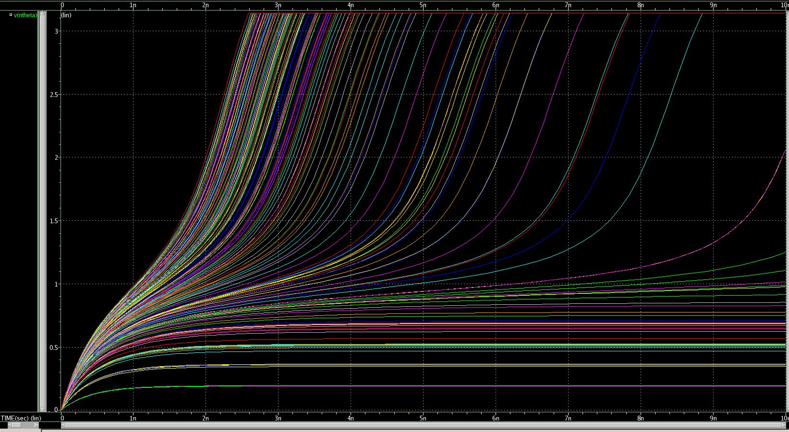
Full Sweep Write Cycle
Radians
Variables:
TopNmos
SinkNmos
Ratio01
Ratio10
Ratio10 * TopNmos = SinkPmos
Ratio01 * SinkNmos = TopPmos
Figure 13: Full Sweep of the Write Cycle
Time (ns)
Notes:
Lowest delay no less than 2.42n. Correlated with largest area; 33+ micro Minimum area without failure was 10u. All of the transistors had minimum values well above .1u Data analysis of best runs: topNmos was consistently the smallest value width (under 2u), followed by topP (around 2.5u), sinkN (around 3u), and sinkP (around 4u) Ranges better understood, tighter sweeps run Made benchmark 3n

Slide 18
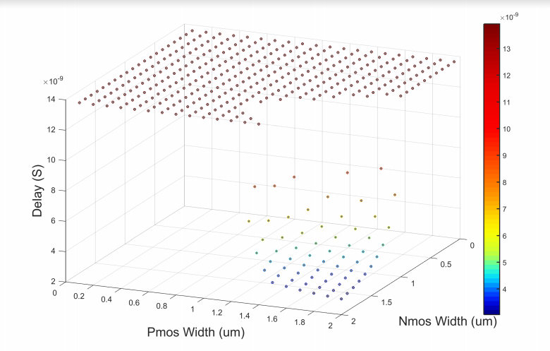
Figure 14: Graph Delay vs Pmos Width vs Nmos Width
Notes:
We had 4 sweeping parameters. In this figure we show the relationship between 2 of those parameters versus delay. In small widths of these parameters, they can not conduct large enough current to flip the MTJs; corresponding to failed delays which are shown to be stuck at the ceiling in this figure. As the sink PMOS and NMOS’s widths are increasing in x and y axises, the delay starts to not fail and have some value. as the PMOS and NMOS increase further, we reach the smallest delay.

Slide 19
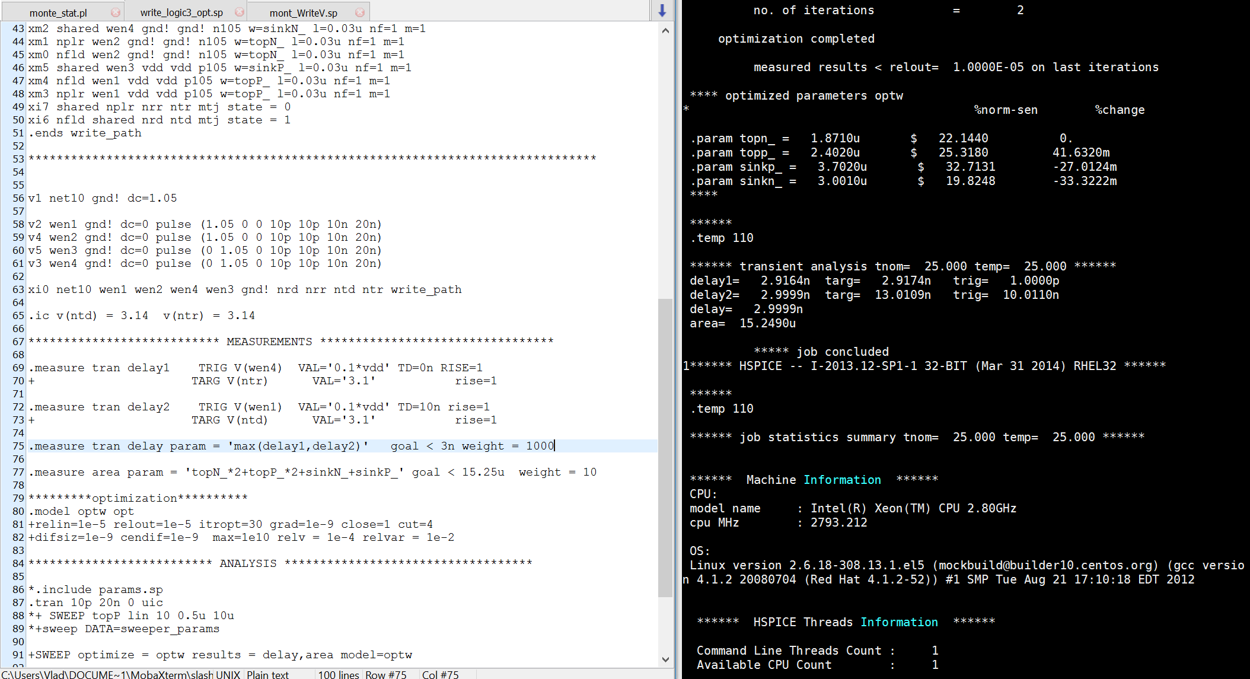
Write Cycle Optimization
Initial goals: less than 3n delay and less than 18u area.
Figure 15: Netlist and Program Execution
Notes:
Next task: find combination of transistors with least area while still operating at less than 3n delay Close initial values picked to be run in optimization netlist for write cycle Initial goals: less than 3n delay and less than 18u area. Values outputted by the optimization program recorded for the final step; failure rate simulations.

Slide 20
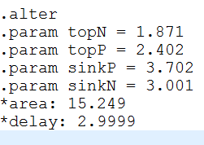
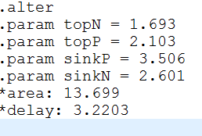
Write Cycle Failure Rate Results
A monte carlo failure rate netlist program was used to test each set of values 1000 times to ensure reliability of the circuit to within 0.1% accuracy. Also did 100 iteration runs.
Looked for values that passed the simulation with 0% failure rate, which meant at least 99.9% reliability for 1000 run.
1000 run: 100 run:
Figure 16: 1000 Run Results of Optimization
Figure 17: 100 Run Results of Optimization
Notes:
because of process variations, the transistors will not have the exact width and length that we intended. also the MTJs will not the same dimension, radius and oxide thickness as designed. Because of these variations, some of them will lead to failure or MTJs not flipping. we can count how many of these failed cases we have out of 100 or 1000 runs.
We modeled these random variances and applied them to each transistor and MTJ, creating these parameters in form of gaussian distribution. and run the netlist for 100 and 1000 times. in every run, the netlist will choose one random point in that gaussian distribution and simulate, then we add all the failed cases out of 100 or 1000 and that is the failure rate.

Slide 21
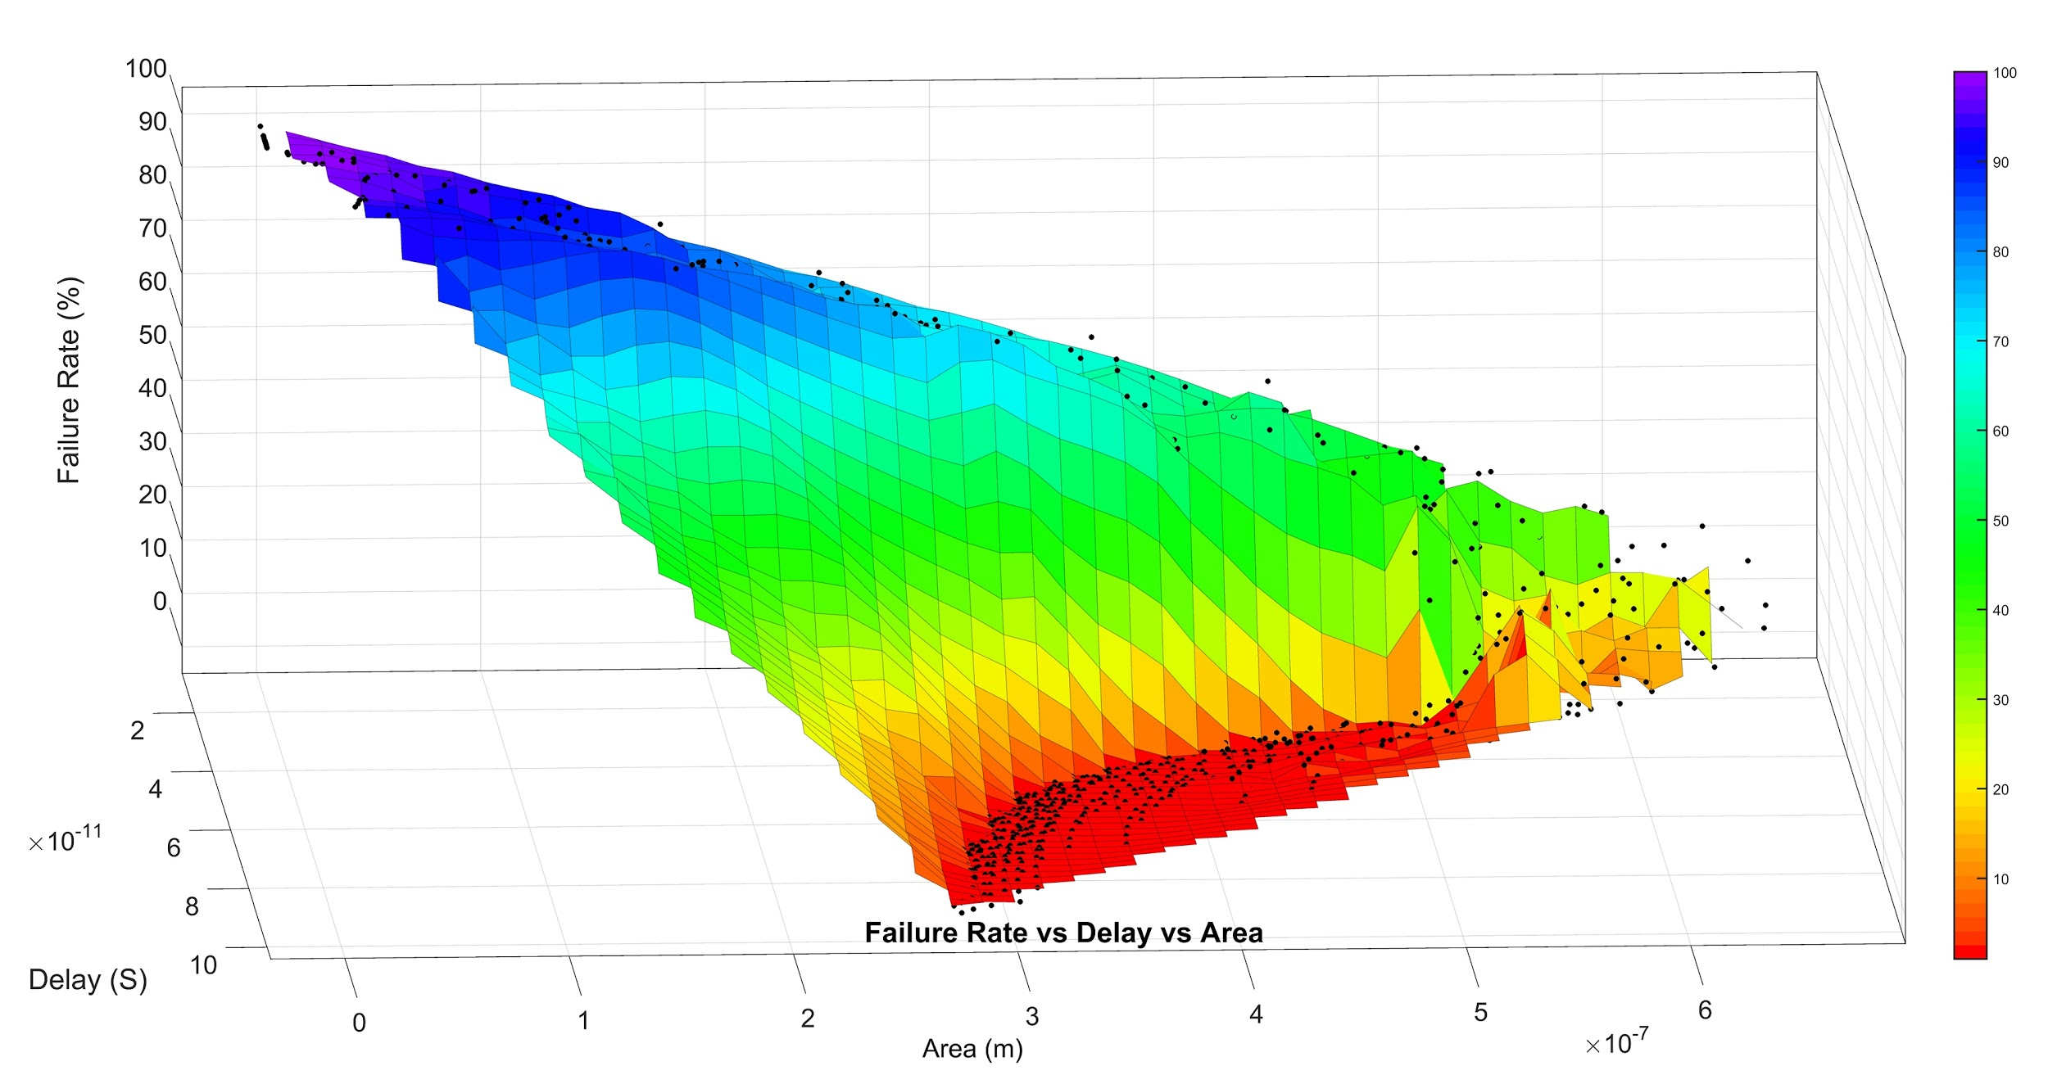
Figure 18.1: Graph of Failure Rate vs Delay vs Area 3D View

Slide 22
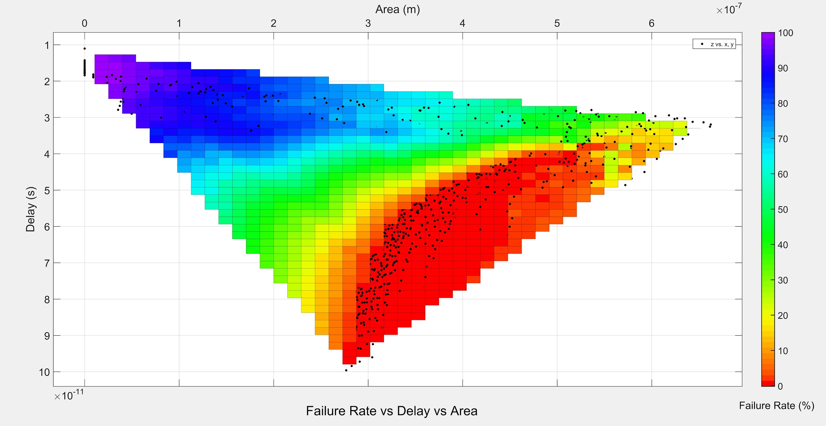
Figure 18.2: Graph of Failure Rate vs Delay vs Area 2D View

Slide 23
Future Tasks
Full Sweep of the Read Operation
Optimization of the Read Operation
Failure Rate Simulations
Latch Layout

Slide 24
Future Tasks
Full Sweep of the Read Operation
Optimization of the Read Operation
Failure Rate Simulations
Latch Layout

